Slide 1
UPPER SIXTH ARTS
GEOGRAPHY
Field Work 6
Fieldwork on Economic Activities
Notes:
Good morning, class, and welcome to our geography lesson. I am your geography teacher, Mr Kamdem. Today we are starting Field Work 6: Fieldwork on Economic Activities.

Slide 2
CLASS INFO
Class, Chapter and Duration
Class | Upper Sixth Arts
Chapter | Module 8: Understanding and carrying out statistical techniques, topographic map analysis, fieldwork and project based learning
Duration | 2 periods (2 × 50 minutes)
Notes:
This lesson is for Upper Sixth Arts. It belongs to Module 8: Understanding and carrying out statistical techniques, topographic map analysis, fieldwork and project based learning. We shall need 2 periods to cover it.

Slide 3
IDENTIFICATION
Lesson Identification
Topic | Fieldwork in Geography
Sub-topic | Field investigations in human geography
Lesson | Field Work 6: Fieldwork on Economic Activities
Notions / Concepts | Farm survey, capital, cottage industry, factory, inputs, traffic count, peak hour.
Syllabus focus | Agricultural systems (variation with distance or relief, influence of capital); industrial systems (inputs of a cottage industry and a modern factory); traffic flows (movement of goods and people, variation over time).
Competence | Learners are able to survey farms, industries and traffic and explain their characteristics.
Notes:
Our topic is Fieldwork in Geography, and the sub-topic is Field investigations in human geography. The key notions we shall use today are: farm survey, capital, cottage industry, factory, inputs, traffic count, peak hour. At the end, you should be able to do this: learners are able to survey farms, industries and traffic and explain their characteristics.

Slide 4

HOMEWORK CORRECTION
Correction of the Homework
Question (Field Work 5: Fieldwork in Biogeography: Soils and Vegetation):
Make a 1 m quadrat and record the plants in three places around the school.
Notes:
Before we start the new lesson, let us correct the homework I gave you at the end of Field Work 5: Fieldwork in Biogeography: Soils and Vegetation. The question was: Make a 1 m quadrat and record the plants in three places around the school. Take out your exercise books.

Slide 5
HOMEWORK CORRECTION
Correction: Possible Answer
Answers vary. Record each quadrat: location, species (grass, herbs, shrubs), % cover and bare ground. Example: shaded area 80 % grass; footpath 20 % grass, 80 % bare.
Notes:
Here is a good answer. Answers vary. Record each quadrat: location, species (grass, herbs, shrubs), % cover and bare ground. Example: shaded area 80 % grass; footpath 20 % grass, 80 % bare. Compare it with your own answer and correct your work in red.

Slide 6
LESSON PLAN
Lesson Plan
Correction of the homework
Objectives and recall
Real-life situation and action to take
Learning activities
Board summary
Evaluation, remediation and homework
Notes:
Here is the plan of our lesson today. First, we shall correct the homework. Then we shall look at the objectives and recall what you already know. After that, we shall study a situation from real life and the action to take, and do the learning activities. Finally, we shall copy the board summary, do the evaluation and the remediation, and I will give you the homework.

Slide 7
OBJECTIVES
Objectives
By the end of this lesson, you should be able to:
Survey how farming changes with distance from a village.
Compare the inputs of a cottage industry and a modern factory.
Notes:
Take your time to copy this part; we will continue together.

Slide 8
OBJECTIVES
Objectives (continued)
Count and analyse traffic flows over time.
Notes:
By the end of this lesson, you should be able to do three things. Number 1: survey how farming changes with distance from a village. Number 2: compare the inputs of a cottage industry and a modern factory. Number 3: count and analyse traffic flows over time.

Slide 9
PREVIOUS KNOWLEDGE
Previous Knowledge
Farms near villages are used more intensively.
Factories need raw materials, labour and capital.
Notes:
Let us first remember what you already know. Farms near villages are used more intensively. Factories need raw materials, labour and capital. Keep this in mind, because we shall build on it today.

Slide 10
REAL-LIFE SITUATION
Situation in Real Life
The class plans three studies: farms at different distances from a village, a pottery workshop and a brewery, and a traffic count on the main road into town.
Notes:
Listen carefully to this situation from real life. The class plans three studies: farms at different distances from a village, a pottery workshop and a brewery, and a traffic count on the main road into town. Think about it, because I am going to ask you some questions.

Slide 11
REAL-LIFE SITUATION
Situation: Question 1
What is the problem in the situation?
Notes:
Question 1: What is the problem in the situation? Think for a moment, then raise your hand to answer.

Slide 12
REAL-LIFE SITUATION
Answer
The class must study economic activities in the field.
Notes:
Good. The class must study economic activities in the field.

Slide 13
REAL-LIFE SITUATION
Situation: Question 2
What tool will they use for farmers?
Notes:
Question 2: What tool will they use for farmers? Think for a moment, then raise your hand to answer.

Slide 14
REAL-LIFE SITUATION
Answer
A questionnaire or interview.
Notes:
Good. A questionnaire or interview.

Slide 15
REAL-LIFE SITUATION
Situation: Question 3
How will they study traffic?
Notes:
Question 3: How will they study traffic? Think for a moment, then raise your hand to answer.

Slide 16
REAL-LIFE SITUATION
Possible Answer
By counting vehicles at fixed times.
Notes:
Good. By counting vehicles at fixed times.

Slide 17
ACTION TO TAKE
Action to Take
Carry out surveys politely and record the answers accurately.
Notes:
From this situation, the action we are working towards in this lesson is the following: carry out surveys politely and record the answers accurately.

Slide 18
JUSTIFICATION
Justification of the Lesson
This fieldwork helps us to understand economic activities around us.
Notes:
Why is this lesson important for you? This fieldwork helps us to understand economic activities around us.

Slide 19
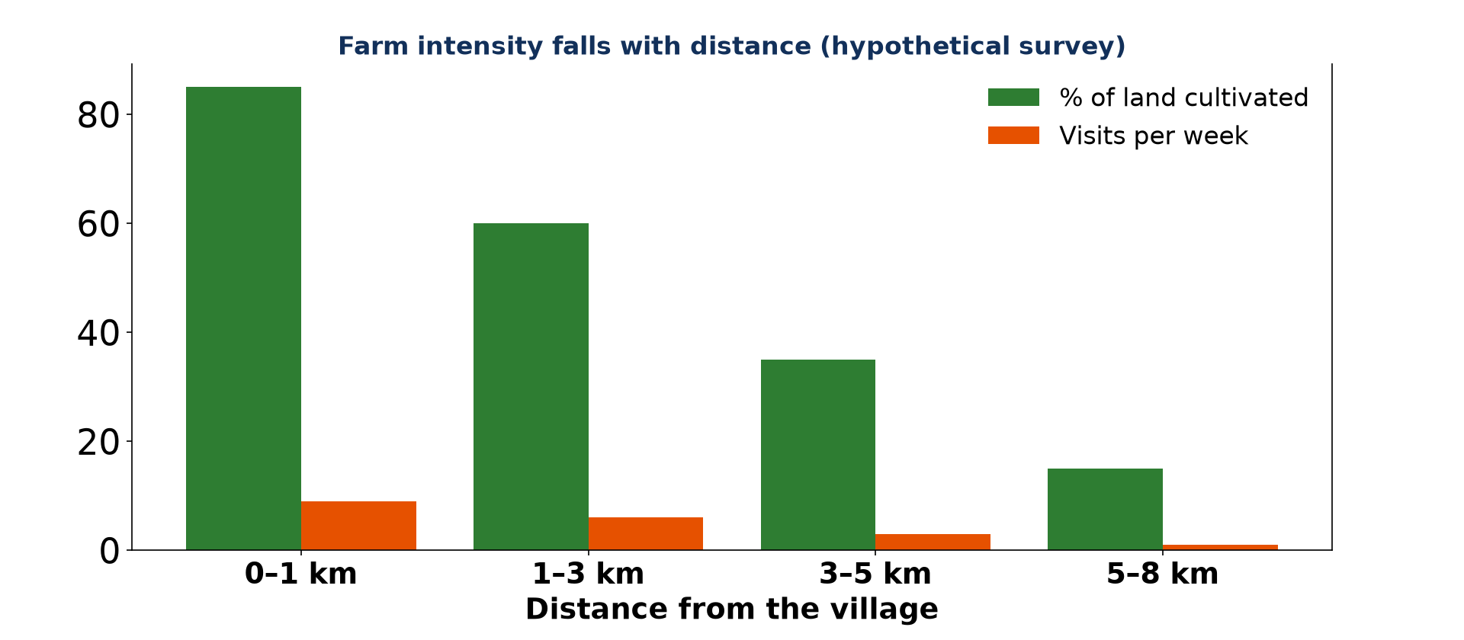
1. FARM SURVEY
Activity 1
Farm intensity and distance (hypothetical).
Notes:
Activity 1. Look carefully at this diagram: farm intensity and distance (hypothetical). Observe every detail before I ask the question.

Slide 20
1. FARM SURVEY
Activity 1: Question
What does the graph show?
Notes:
Here is the question for Activity 1: What does the graph show? Take one minute to think and write your answer in your rough notebook.

Slide 21
1. FARM SURVEY
Activity 1: Answer
Land use and visits decrease as distance from the village increases.
Notes:
Let us check the answer together. Land use and visits decrease as distance from the village increases.

Slide 22

1. INFLUENCE OF CAPITAL
Activity 2
A combine harvester: capital-intensive farming.
Notes:
Activity 2. Look carefully at this picture: a combine harvester: capital-intensive farming. Observe every detail before I ask the question.

Slide 23
1. INFLUENCE OF CAPITAL
Activity 2: Question
How does invested capital change farm characteristics?
Notes:
Here is the question for Activity 2: How does invested capital change farm characteristics? Take one minute to think and write your answer in your rough notebook.

Slide 24
1. INFLUENCE OF CAPITAL
Activity 2: Answer
More capital brings machines, fertiliser and higher yields.
Notes:
Let us check the answer together. More capital brings machines, fertiliser and higher yields.

Slide 25
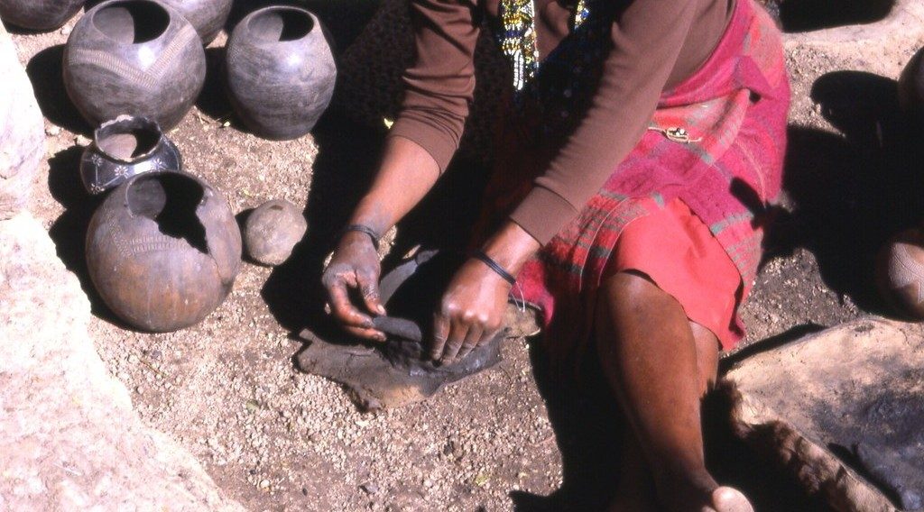
2. COTTAGE INDUSTRY
Activity 3
Pottery, a cottage industry.
Notes:
Activity 3. Look carefully at this picture: pottery, a cottage industry. Observe every detail before I ask the question.

Slide 26
2. COTTAGE INDUSTRY
Activity 3: Question
Give two characteristics of a cottage industry.
Notes:
Here is the question for Activity 3: Give two characteristics of a cottage industry. Take one minute to think and write your answer in your rough notebook.

Slide 27
2. COTTAGE INDUSTRY
Activity 3: Answer
Local raw materials and family labour (also hand tools, local market).
Notes:
Let us check the answer together. Local raw materials and family labour (also hand tools, local market).

Slide 28
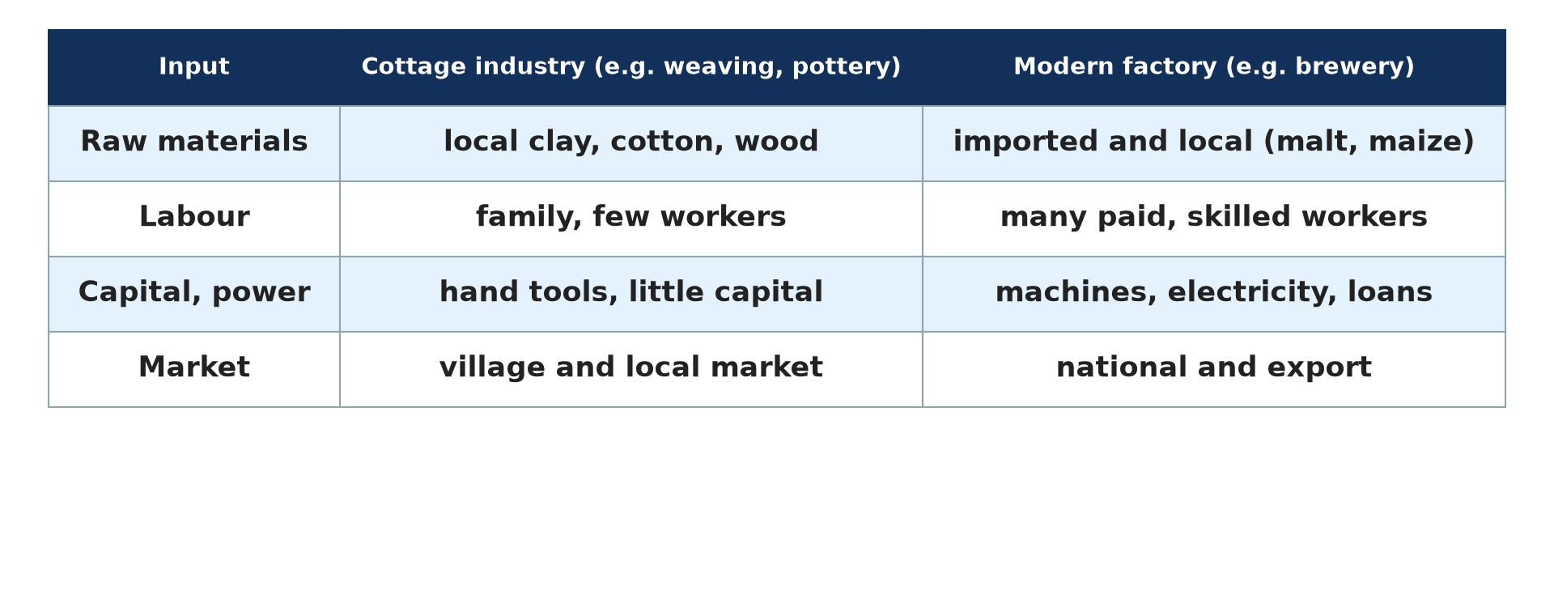
2. MODERN FACTORY
Activity 4
Inputs compared.
Notes:
Activity 4. Look carefully at this diagram: inputs compared. Observe every detail before I ask the question.

Slide 29
2. MODERN FACTORY
Activity 4: Question
Compare the labour of a cottage industry and a modern factory.
Notes:
Here is the question for Activity 4: Compare the labour of a cottage industry and a modern factory. Take one minute to think and write your answer in your rough notebook.

Slide 30
2. MODERN FACTORY
Activity 4: Answer
Cottage: few family workers. Factory: many paid, skilled workers.
Notes:
Let us check the answer together. Cottage: few family workers. Factory: many paid, skilled workers.

Slide 31
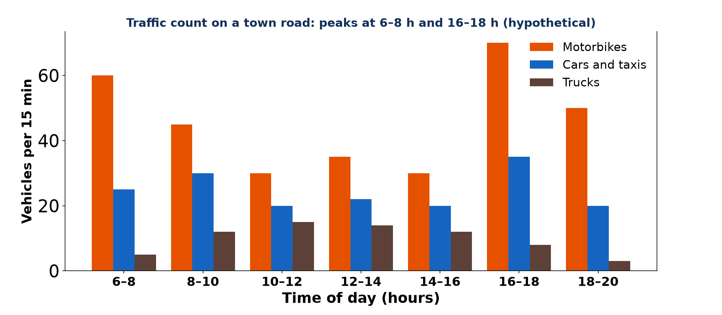
3. TRAFFIC FLOWS
Activity 5
A traffic count (hypothetical).
Notes:
Activity 5. Look carefully at this diagram: a traffic count (hypothetical). Observe every detail before I ask the question.

Slide 32
3. TRAFFIC FLOWS
Activity 5: Question
When are the peak hours, and why?
Notes:
Here is the question for Activity 5: When are the peak hours, and why? Take one minute to think and write your answer in your rough notebook.

Slide 33
3. TRAFFIC FLOWS
Activity 5: Answer
6–8 h and 16–18 h, when people go to and return from work and school.
Notes:
Let us check the answer together. 6–8 h and 16–18 h, when people go to and return from work and school.

Slide 34
BOARD SUMMARY
Board Summary
Topic: Fieldwork in Geography
Sub-topic: Field investigations in human geography
Field Work 6: Fieldwork on Economic Activities
Notes:
Now we are going to copy the board summary. Write the title and the headings neatly in your notebooks. I will give you enough time for each slide, so do not rush.

Slide 35
BOARD SUMMARY
1. Agricultural Systems
Farms are studied in the field as follows:
Variation with distance or relief: Farms are surveyed along a line from the village or up a slope. Land use and visits usually decrease with distance.
Notes:
Let us copy Agricultural Systems. Farms are studied in the field as follows. On this slide we have Variation with distance or relief. Write each point on a new line, with the key term first, and explain it in your own words when we revise. When you finish, we go to the next slide.

Slide 36
BOARD SUMMARY
1. Agricultural Systems (continued)
Influence of capital: Farmers are asked about machines, fertilisers and workers. More capital gives higher yields and larger farms.
Notes:
We continue with Agricultural Systems. On this slide we have Influence of capital. Write each point on a new line, with the key term first, and explain it in your own words when we revise.

Slide 37
BOARD SUMMARY
1. Agricultural Systems
Illustration: farm intensity and distance (hypothetical)
Notes:
Now draw this illustration in your notebook: farm intensity and distance (hypothetical). Give it a title and label it clearly.

Slide 38
BOARD SUMMARY
2. Industrial Systems
Industries are compared as follows:
Cottage industry: It uses local raw materials, family labour and hand tools. It sells to a local market.
Modern factory: It uses machines, many paid skilled workers and power. Its raw materials and markets may be far away.
Notes:
Let us copy Industrial Systems. Industries are compared as follows. On this slide we have Cottage industry and Modern factory. Write each point on a new line, with the key term first, and explain it in your own words when we revise.

Slide 39
BOARD SUMMARY
2. Industrial Systems
Illustration: inputs compared
Notes:
Now draw this illustration in your notebook: inputs compared. Give it a title and label it clearly.

Slide 40
BOARD SUMMARY
3. Traffic Flows
Traffic is studied as follows:
Traffic count: Vehicles are counted by type at a point for fixed periods, such as 15 minutes each hour. The results are shown on bar or line graphs.
Notes:
Let us copy Traffic Flows. Traffic is studied as follows. On this slide we have Traffic count. Write each point on a new line, with the key term first, and explain it in your own words when we revise. When you finish, we go to the next slide.

Slide 41
BOARD SUMMARY
3. Traffic Flows (continued)
Peak hours: Traffic is highest in the morning and evening when people go to and return from work and school. Flows are higher on main roads and near the market.
Notes:
We continue with Traffic Flows. On this slide we have Peak hours. Write each point on a new line, with the key term first, and explain it in your own words when we revise.

Slide 42
BOARD SUMMARY
3. Traffic Flows
Illustration: a traffic count (hypothetical)
Notes:
Now draw this illustration in your notebook: a traffic count (hypothetical). Give it a title and label it clearly.

Slide 43
FORMATIVE EVALUATION
Evaluation 1
Give two differences between a cottage industry and a factory.
Notes:
Now let us check what you have understood. Question 1: Give two differences between a cottage industry and a factory. Answer in your exercise book.

Slide 44
FORMATIVE EVALUATION
Expected Answer
Labour: family vs many workers. Capital: little vs much.
Notes:
The expected answer is: labour: family vs many workers. Capital: little vs much. If you got it right, well done.

Slide 45
FORMATIVE EVALUATION
Evaluation 2
Why does traffic peak at 7 h?
Notes:
Now let us check what you have understood. Question 2: Why does traffic peak at 7 h? Answer in your exercise book.

Slide 46
FORMATIVE EVALUATION
Expected Answer
People travel to work and school.
Notes:
The expected answer is: people travel to work and school. If you got it right, well done.

Slide 47
REMEDIATION
Remediation
Fill in the blanks:
A home-based industry is a ______ industry.
Busiest times are ______ hours.
Farm intensity ______ with distance.
Notes:
For those who need more practice, fill in the blanks in your exercise book. The answers are: number 1, cottage; number 2, peak; number 3, falls.

Slide 48
HOMEWORK
Homework
Count vehicles passing your house for 15 minutes in the morning and evening and compare.
Notes:
For your homework: Count vehicles passing your house for 15 minutes in the morning and evening and compare. We shall correct it at the beginning of our next lesson.

Slide 49
NEXT LESSON
Next Lesson
Our next lesson will be on:
Field Work 7: Fieldwork on Settlement
Notes:
Our next lesson will be on Field Work 7: Fieldwork on Settlement. Thank you for your attention, and see you next time.

Slide 50
BILINGUAL GAME
Bilingual Game (Jeu Bilingue)
English | Français
Farm | L'exploitation agricole
Capital | Le capital
Workshop | L'atelier
Traffic | La circulation
Count | Le comptage
Peak hour | L'heure de pointe
Notes:
Let us play the bilingual game. I say a word in English, and you give me the French word. Then we do the reverse.

Slide 51
LOGBOOK
Official Logbook (1/2)
Module / Topic | Fieldwork in Geography
Lesson Title | Field Work 6: Fieldwork on Economic Activities
Expected Learning Outcomes | Survey how farming changes with distance from a village. Compare the inputs of a cottage industry and a modern factory. Count and analyse traffic flows over time.
Competence | Learners are able to survey farms, industries and traffic and explain their characteristics.
Notes:
I record this information in the official logbook of the class after the lesson.

Slide 52
LOGBOOK
Official Logbook (2/2)
Matter Taught | Agricultural Systems; Industrial Systems; Traffic Flows.
Evaluation | Formative evaluation and remediation exercise.
Homework | Count vehicles passing your house for 15 minutes in the morning and evening and compare.
Enrolment / Present / Absent | ____ / ____ / ____
Achievement | To be completed after the lesson.
Notes:
I complete the second page of the logbook: the matter taught, the evaluation, the homework and the attendance.

Slide 53
TEACHER'S NOTE
Teacher's Note
Timing: Homework correction, plan, objectives 8 min | Recall, situation, action 10 min | 5 activities 30 min | Board summary (copying) 30 min | Evaluation, remediation 10 min | Homework, next lesson 5 min | Logbook 7 min
Without the projector (Activity 1): read the bars.
Without the projector (Activity 2): interview a farmer.
Without the projector (Activity 3): visit a workshop.
Without the projector (Activity 4): complete the table.
Without the projector (Activity 5): read the graph.
Notes:
This slide is for me, the teacher: it gives the timing of the lesson and what to do if the projector is not available.

Slide 54
REFERENCES
References
National Geography Syllabus, MINESEC/IGE/IP-SS, 2019 — Module 8 (Practical Geography).
Photo, Activity 2: “John Deere Combine” by SnoShuu, CC BY-NC-ND 2.0, via Flickr (https://www.flickr.com/photos/85888233@N00/2776467094)
Photo, Activity 3: “Zulu woman at a reconstructed traditional village in South Africa roll” by gbaku, CC BY-SA 2.0, via Flickr (https://www.flickr.com/photos/72105154@N00/2355358070)
Diagrams and animations: drawn for this lesson (Geography Department).
Notes:
These are the references and picture credits used to prepare this lesson.

